Slide 1
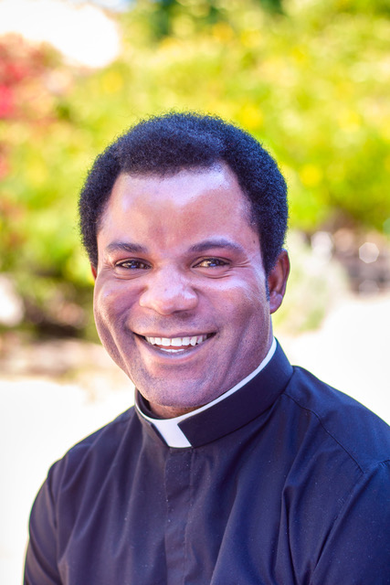
Where there’s a will there’s a way
Together we can make a big difference in our world.

Slide 2
My Story
As a child growing up, I was blessed to have a father who taught me the importance of an education and a mother who showed me what it was to be a servant leader by caring for people in our community as a nurse. Her dedication, sacrifice and passion for healing others inspired me to pursue a degree to be a medical doctor. However, God had a different plan. In answering his call to be a Catholic Priest, I realized that I could still serve and care for people who are suffering.
In 2012 I was ordained as a priest in the Via Christi Society and was assigned to the Holy Ghost Parish in Makurdi which is the capital of Benue State, Nigeria. To take care of the spiritual needs of our parish in Makurdi, I founded Holy Ghost Prayer Ministry which held monthly meetings to celebrate sacraments, address prayer requests and provide direction to the people.
My view of the world changed significantly in 2015 when I was transferred to Sacred Heart Parish (a rural parish in Guma local government area of Benue State serving about 100,000 people). There I witnessed death, poverty and an unbelievable need for basic amenities due to an ethnic war against the Fulani herdsman. Guma had a great need for such things as clean water, schools, healthcare centers, houses, roads, power, food and basic safety. It broke my heart to see people living in these conditions and I knew something had to be done to restore hope to this community.

Slide 3
My Story Continues
My first priority was to provide clean water for the church, schools, clinic and neighbors. The good news – a well was already there. The bad news – the well was not functioning and because of the war, the church was unable to make repairs. Knowing clean water is the foundation for healthy living I took the initiative to meet with contractors to estimate and make necessary repairs to the well. This was accomplished within a short period of time after I arrived. This small well provides water to approximately 500 people.
The lack of consistent and timely health care was the second priority that needed urgent attention now that the war was over. The local hospital was under the parish supervision and there was only one nurse. Growing up with a mom who was a nurse, provided me an understanding and knowledge of processes that allowed me to discuss, negotiate and convince the local doctors in Makurdi to come to Guma when they were on vacation and provide free or subsidized health care for patients at Sacred Heart’s hospital. What a difference this made to the small community.
Next on my list was reviving the parish elementary and high schools. My dad taught me the importance of education and we know education and knowledge empower people and instill confidence, so we worked to get the schools operational again.

Slide 4
Maps of Nigeria and Benue State

Slide 5
The population in Benue State
Name | Status | Population Census 1991-11-26 | Population Census 2006-03-21 | Population Projection 2016-03-21
Benue | State | 2,753,077 | 4,253,641 | 5,741,800
Ado | Local Government Area | 104,137 | 184,389 | 248,900
Agatu | Local Government Area | ... | 115,597 | 156,000
Apa | Local Government Area | ... | 96,780 | 130,600
Buruku | Local Government Area | 130,450 | 206,215 | 278,400
Gboko | Local Government Area | ... | 361,325 | 487,700
Guma | Local Government Area | 116,336 | 194,164 | 262,100
Gwer East | Local Government Area | 117,630 | 168,660 | 227,700
Gwer West | Local Government Area | 74,588 | 122,313 | 165,100
Katsina-Ala | Local Government Area | ... | 225,471 | 304,400
Konshisha | Local Government Area | 145,614 | 226,492 | 305,700
Kwande | Local Government Area | 180,327 | 248,642 | 335,600
Logo | Local Government Area | ... | 169,570 | 228,900
Makurdi | Local Government Area | 239,889 | 300,377 | 405,500
Obi | Local Government Area | ... | 98,707 | 133,200
Ogbadibo | Local Government Area | 89,497 | 130,988 | 176,800
Ohimini | Local Government Area | ... | 70,688 | 95,400

Slide 6
The population in Benue State
.
Name | Status | Population Census 1991-11-26 | Population Census 2006-03-21 | Population Projection 2016-03-21
Oju | Local Government Area | ... | 168,491 | 227,400
Okpokwu | Local Government Area | 90,241 | 175,596 | 237,000
Oturkpo | Local Government Area | ... | 266,411 | 359,600
Tarka | Local Government Area | ... | 79,280 | 107,000
Ukum | Local Government Area | 167,266 | 216,983 | 292,900
Ushongo | Local Government Area | 123,166 | 191,935 | 259,100
Vandeikya | Local Government Area | 161,863 | 234,567 | 316,600
Nigeria | Federal Republic | 88,992,220 | 140,431,790 | 193,392,500
Notes:
Source: National Population Commission of Nigeria (web), National Bureau of Statistics (web).
Explanation: The population projection assumes the same rate of growth for all LGAs within a state. The undercount of the 1991 census is estimated to be about 25 million. All population figures for Nigeria show high error rates; census results are disputed

Slide 7
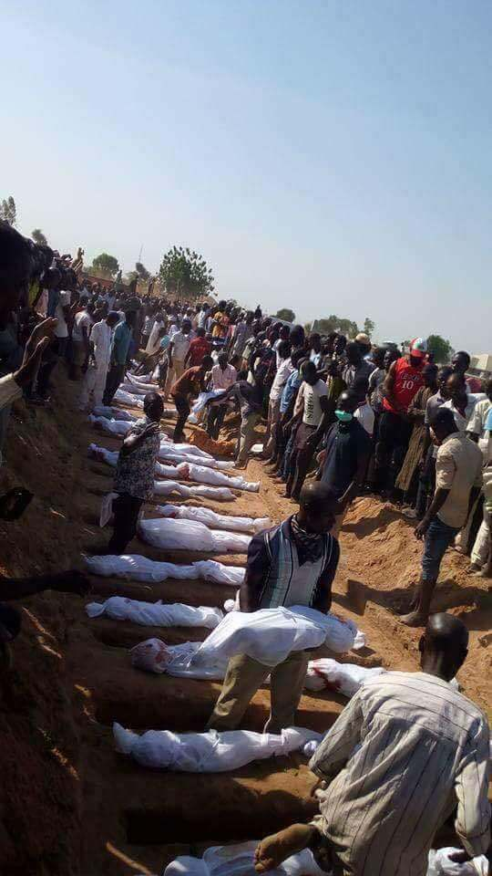
Benue State people hastily pick up the bodies of their loved ones.
Notes:
Just go online and google killing in Benue State, Nigeria.

Slide 8
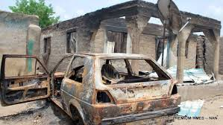
Just a glimpse of some of the tragedy and devastation in Benue.

Slide 9
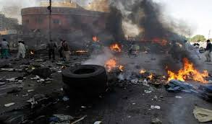
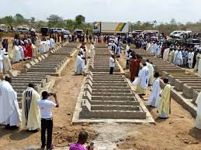
Villagers defending themselves against the military, fires everywhere and mass burials.

Slide 10
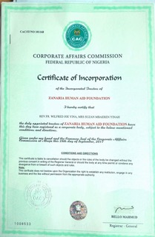
The devastation, lack of involvement by local government and the despair of this community tugged at my heart. I wanted and needed to do more to help. Because I had no financial resources to accomplish what I knew needed to be done, I started this foundation to reach others who have the financial ability, commitment and who enjoy helping others less fortunate. I named it after my mother because her passion and commitment for helping others is what shaped my desire and ultimately to accept my calling to help others through the vocation of priesthood.

Slide 11
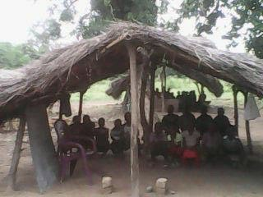
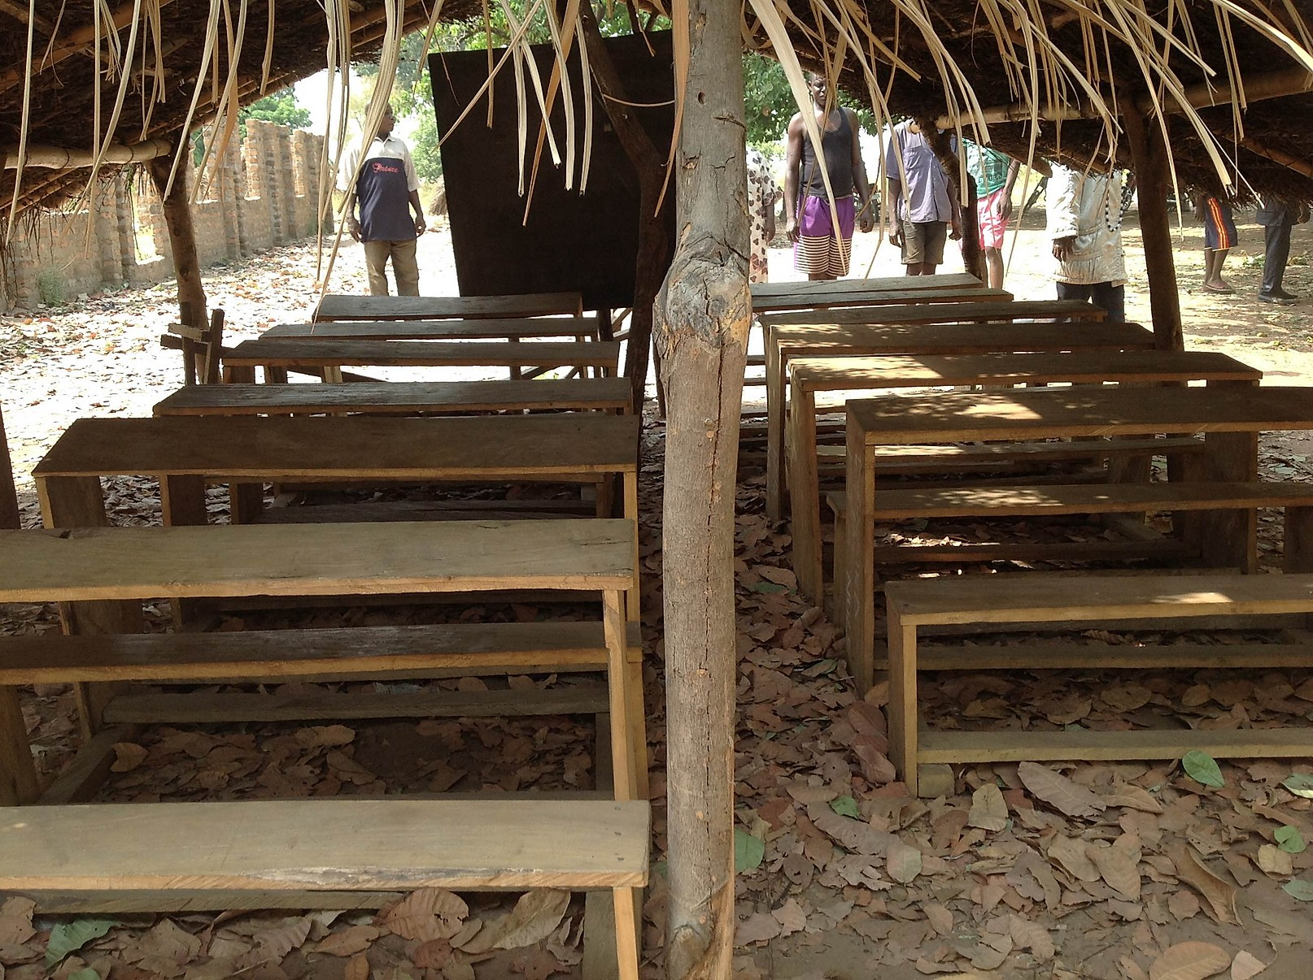
Through the grace of God, I was able to help the community of Nule (200 kids between age 2-10) set up the St. Francis Nursery/Primary School. Because my funds were extremely limited, I started the school in tents made of trees and palm branches. My goal is to build a structure with concrete blocks and other building materials to provide a safer and more stable learning environment.

Slide 12
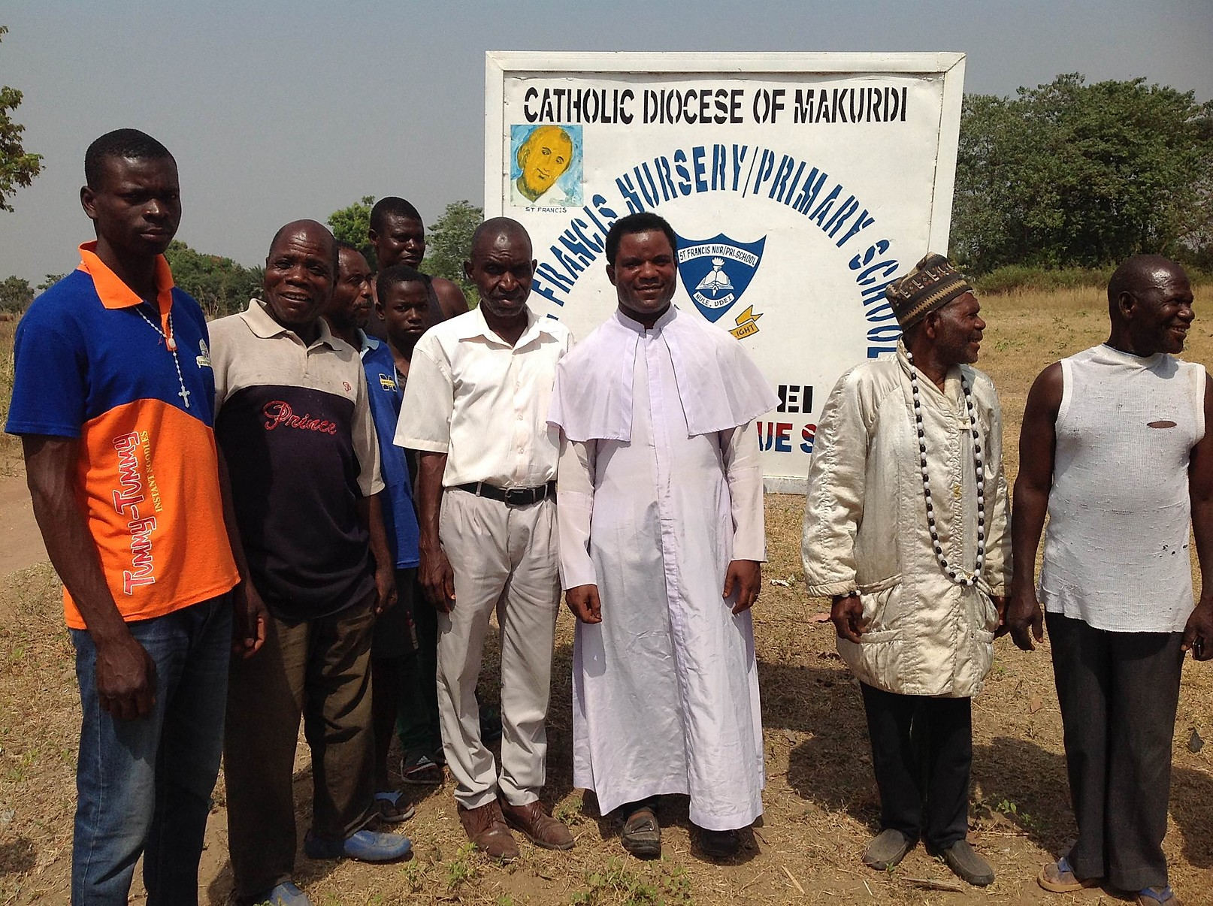
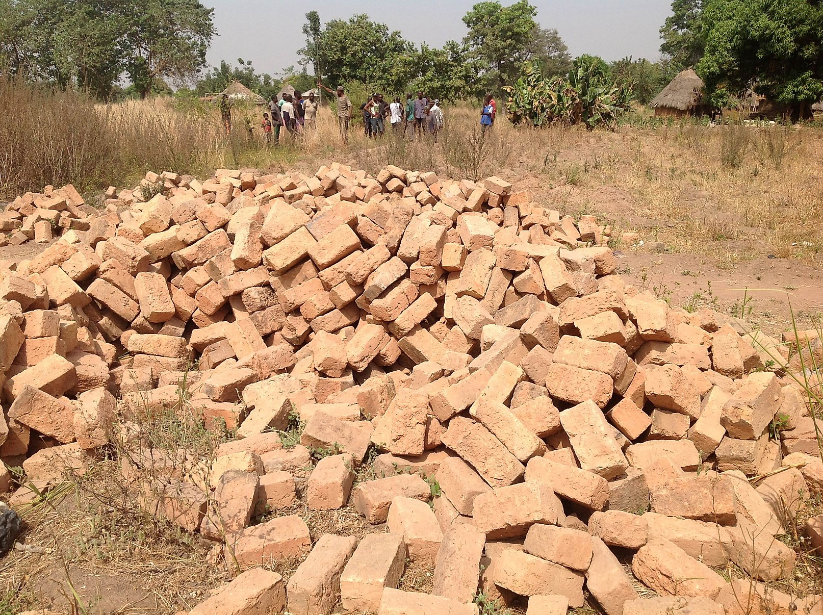
With land donated by the local chief and blocks given to me through the community, we started building our school. However, construction was halted because we need additional funds and materials. My goal is to reach out to the community and hopefully, through their generosity, we’ll receive enough money to continue building the school.

Slide 13
WHERE THERE’S A WILL THERE’S A WAY
I strongly believe “WHERE THERE’S A WILL THERE’S A WAY”. The desire to help these communities is the reason the Zanaria Human Aid Foundation was started in 2016 in Benue State of Nigeria.

Slide 14
ZHAF is a 501(3)C Charity registered with State of Arizona Tax ID # 83-3892349

Slide 16
ZANARIA HUMAN AID FOUNDATION (ZHAF)
OUR MISSION
Zanaria Human Aid Foundation aims to reach out, give hope, rehabilitate, educate and empower impoverished rural communities with focus on youth/women in order to achieve individual and community transformation.
OUR MOTTO
Provide aid to improve quality of living in rural communities.
OUR VISION
Development/empowerment for the youth and women with emphasis on girls
Standard education for every child
Good health care for rural community residents

Slide 17
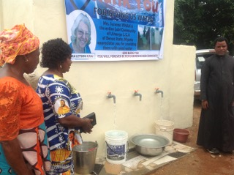
In 2018, one of my priorities when I left Benue was to get fresh water to the community. Through a generous donation from a local parishioner in the USA we were able to drill a small well that will provide clean water for approximately 500 people.

Slide 18
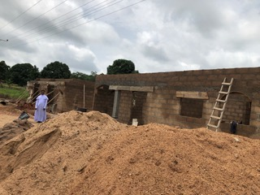
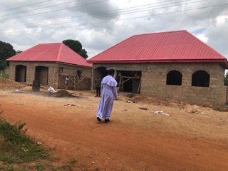
One of my dreams of providing affordable health care to the community came true when the construction of a clinic was completed and opened in September 2019.

Slide 19
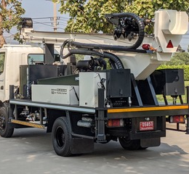
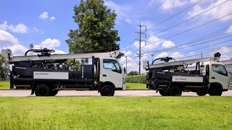
The most efficient and cost effective way to accomplish our main goal of providing water to the community is to buy a drilling rig for $150,000.

Slide 20
WHY WE NEED A DRILLING RIG
Cost of drilling a borehole in Nigeria = $6,500.
One borehole serves up to five hundred (500) people.
Guma Local Government for example has a population of 262,100 people according to Population Census report of 2016.
524 boreholes are needed to serve just Guma LGA.
We can save $3000 per borehole if we have the drilling rig.
Owning a drilling rig will significantly reduce the time of the project and the hassle of finding a contractor.
This will provide life saving wells with fresh water to our brothers and sisters of God on the other side of the world.

Slide 21
Make a difference in someone’s life today!
Sometimes miracles are just good people with kind hearts that God has sent to you. You may never know the true impact you have on the world; make the impact anyway and help to change lives with clean water.
We can’t often choose our circumstances but we can control our actions. Be the miracle these people need by donating now to help us bring clean water to their village.
God bless!

